Slide 1
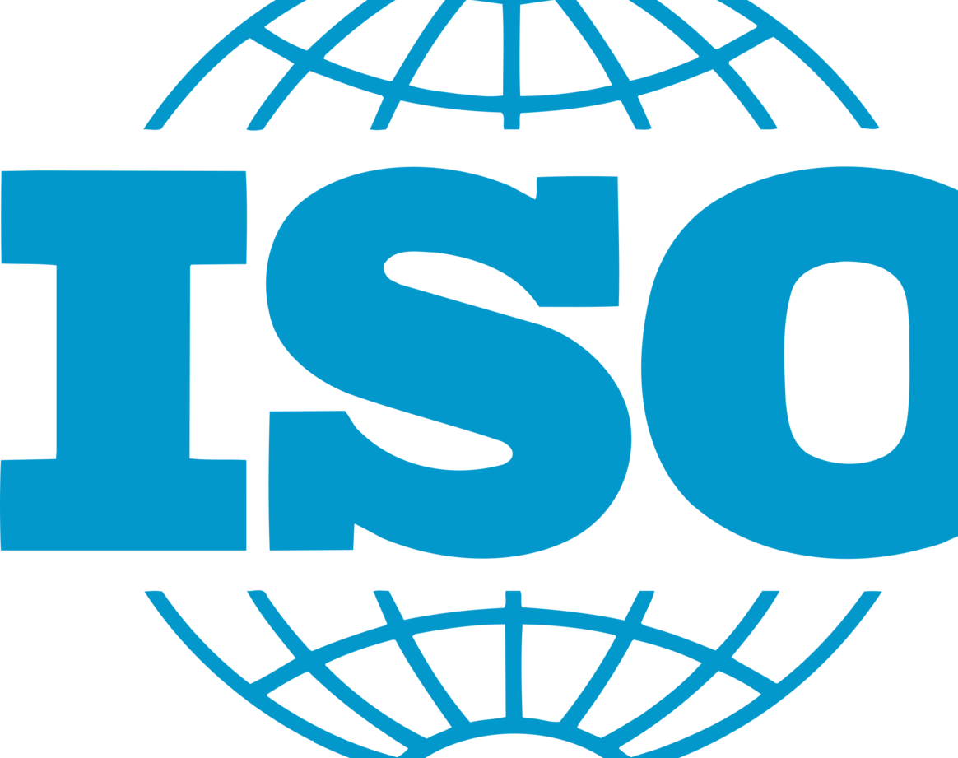
ISO Compliance
By: Ankit Trivedi

Slide 2
Outline:
What is ISMS​
What is CIA​
What is IEC​
What is ISO​
ISO Standards​
ISO/IEC 27001
Comparison
ISO/IEC 27017
ISO/IEC 27018
Resources

Slide 3
What is ISMS:
An Information Security Management System describes and demonstrates your organization's approach to information security and privacy. It will help you identify and address the threats and opportunities around your valuable information and any related assets. ​
Benefits:​
Help you win new business and enter new sectors​
Strengthen your relationship with your existing customers​
Build your organization's brand and reputation​
Protect your business from security breaches​

Slide 4
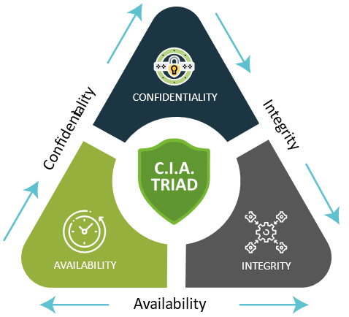
What is CIA Triad:
The CIA triad is a foundational model in information security that stands for confidentiality, integrity, and availability. CIA triad is the base for development of security systems. It represents three core objectives that information security professionals strive to achieve.

Slide 5
CIA TRIADS:
Confidentiality: Keeping data secret or private, controlling access to information, and preventing unauthorized sharing of data. ​
Access Control Policy​
Integrity: Guarding the accuracy and completeness of information, making sure data is trustworthy and free from tampering​
Hashing​
Encryption​
Digital Certificate.​
Availability: Guaranteeing that authorized users have access to information and systems whenever needed.​
Redundant networks, servers, and applications​
Disaster recovery.
Secure Communication Channel.​
Multi-Factor-Authentication​

Slide 6
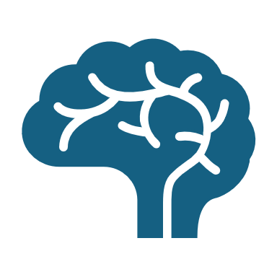
What is IEC:
The International Electrotechnical Commission (IEC) founded in June 1906 London, UK is a not-for-profit organization that creates and publishes international standards for electrical, electronic, and related technologies, often referred to collectively as "electrotechnology".​
Benefits:
Safety​
Quality​
Trade​
Fair Competition​

Slide 7
What is ISO:
The International Organization for Standardization, also known as ISO, is an independent, non-governmental organization that plays a crucial role in establishing international standards. ​
It creates uniform rule systems for different fields like health, energy, quality and other industries allowing businesses to interact smoothly with their counterparts around the world.

Slide 8
ISO Standards:
ISO 9001: Quality management systems​
ISO 45001: Occupational health and safety​
ISO 14001: Environmental management systems​
ISO 13485: Medical devices Quality​
ISO 22000: Food safety management

Slide 9
Comparison:
(ISO) and (IEC) jointly publish the ISO/IEC 27000 series of standards, which helps organizations protect their data and assets. The series is also known as the ISMS family of standards or ISO27K.
Standard​ | Focus​ | Target Audience​
ISO/IEC 27001:2013 (2022)​ | Overall information security management​ | Organizations of all sizes and industries​
ISO/IEC 27017:2015​ | Cloud security​ | Organizations using cloud services (providers or customers)​
ISO/IEC 27018:2019​ | Protecting PII in the cloud​ | Cloud service providers handling PII​

Slide 10

ISO/IEC: 27017
It provide guidelines for controls related to cloud services and additional 37 guidelines specified in ISO/IEC 27002.
Who is responsible for what between the cloud service provider and the cloud customer.
The removal or return of assets at the end of a contract.
Protection and separation of the customer's virtual environment.
Virtual machine configuration.
Administrative operations and procedures associated with the cloud environment.
Cloud customer monitoring of activity.
Virtual and cloud network environment alignment.

Slide 11
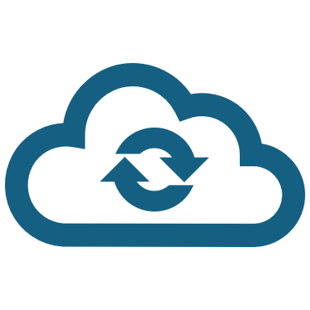
ISO/IEC: 27018
ISO/IEC 27018 is the international standard for protecting personal information in cloud storage. The standard targets public cloud services providers that act as PII (Personally Identifiable Information) processors.
Help the public cloud PII processor meet their obligations.
Enable transparency, so prospective cloud service customers can access secure, well managed cloud-based PII processing services.
Help cloud services and users establish contractual agreements for processing PII.
Give cloud service customers an audit and compliance methodology.

Slide 12

Resources:
https://www.iso.org/standards.html
https://www.isms.online/iso-27001/
https://www.techtarget.com/searchdatacenter/definition/ISO
https://www.iec.ch/what-we-do
https://gemini.google.com/app

